Slide 1

Electricity Bill Generator
using PYTHON and STREAMLIT
BAYYA ARAVIND
BATCH : 577

Slide 2
About Me
I’m BAYYA ARAVIND, and I recently completed my Bachelor’s degree in Engineering in Information Technology (IT) from MVSR Engineering College.
Github : https://github.com/Aravindbayya
LinkedIn : www.linkedin.com/in/bayya-aravind139904245
"I chose Data Science because I am interested in analyzing data, discovering meaningful insights, and solving real-world problems. I want to develop practical skills in Python, data analysis, visualization, and machine learning to make data-driven decisions. My goal is to apply these skills to solve business problems and build intelligent, useful solutions."

Slide 3
Agenda
Business Problem
Business Problem Statement
Business Requirements
Project Objective
Workflow Diagram
Insights
Recommendations
Conclusion

Slide 4
In many households and commercial establishments, electricity bills are calculated based on the number of units consumed during a billing period. Calculating bills manually can be time-consuming and may lead to errors in unit charges, surcharges, and total amounts.
Business Problem

Slide 5
Business Problem Statement
The Electricity Bill Generator is a Python-based application developed using Streamlit that automates the electricity billing process. The application accepts customer details, consumer number, and electricity units consumed. It calculates the energy charges based on predefined tariff slabs, applies an additional surcharge when applicable, and displays the final electricity bill.

Slide 6
Business Requirements
⮞ Manage electricity consumption details for each customer.
⮞ Add customer details such as customer name and consumer number.
⮞ Apply conditional statements to determine the correct charges for different unit
consumption levels.
⮞ Provide a user-friendly interface for generating electricity bills using Streamlit.
⮞ Calculate a 5% surcharge when electricity consumption exceeds 300 units.
⮞ Display complete bill details, including customer information, units consumed, energy charges, surcharge, and total amount.
⮞ Reduce manual calculations and minimize billing errors.
⮞ Improve billing accuracy, efficiency, and transparency.
⮞ Simplify the electricity billing process through automation.
⮞ Generate the final electricity bill by adding energy charges and applicable surcharges.

Slide 7
Project Objective
The main objective of this project is to develop a user-friendly Electricity Bill Generator using Python and Streamlit. It automates electricity bill calculations based on units consumed and predefined tariff slabs. An additional 5% surcharge is applied when consumption exceeds 300 units. The application displays customer details, energy charges, surcharge, and the final bill amount.It reduces manual errors, saves time, and demonstrates Python concepts such as classes, objects, functions, and conditional statements.

Slide 8
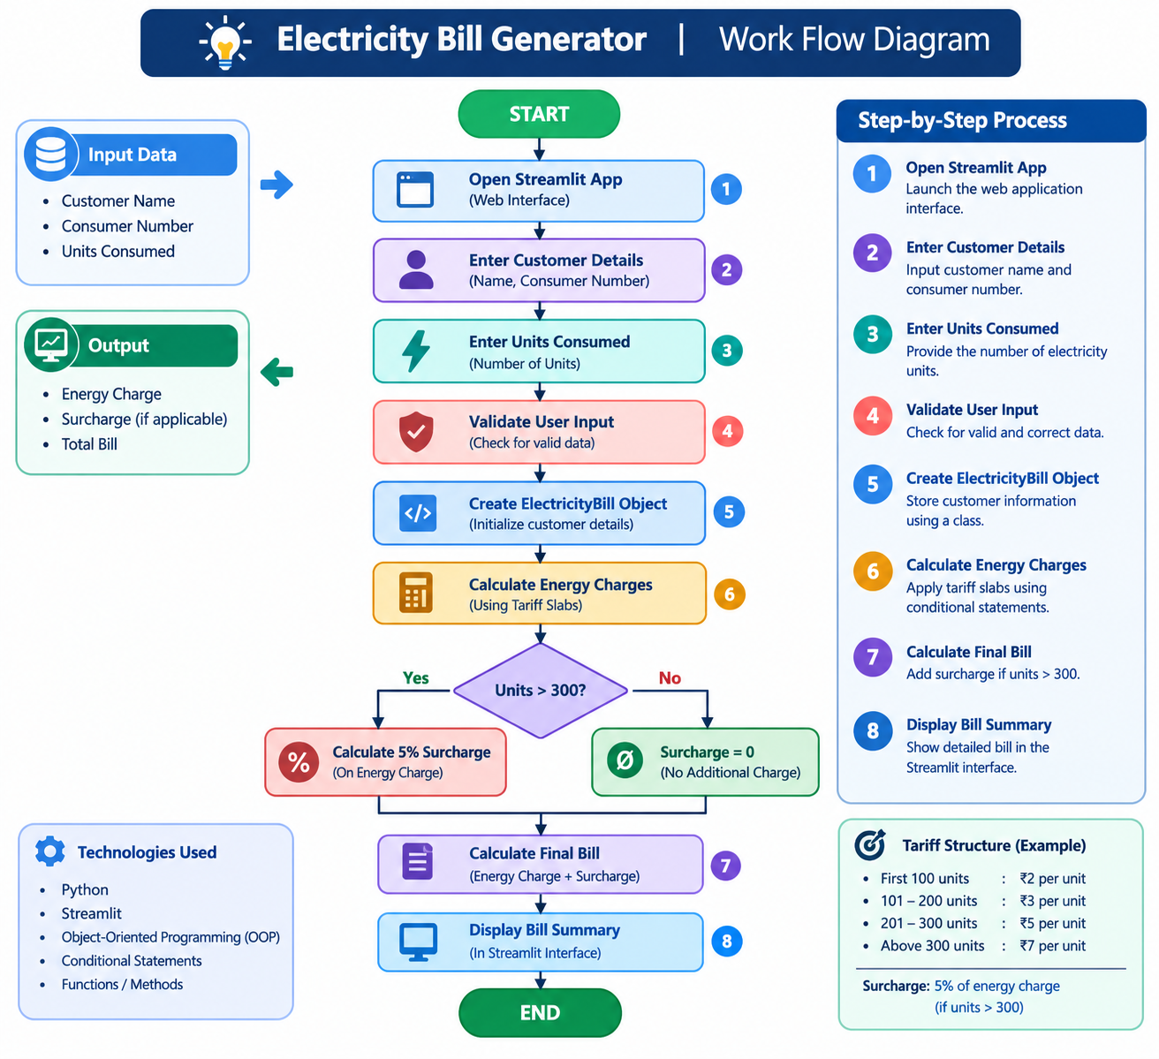
Work Flow Diagram

Slide 9
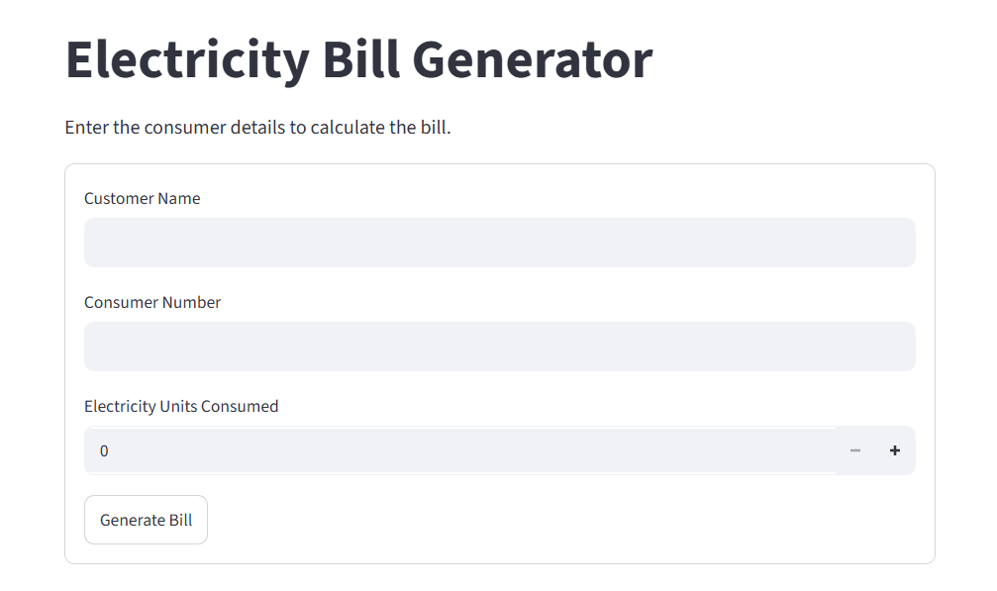
Electricity Bill Generator
Insights
The Electricity Bill Generator application developed using Python and Streamlit. The interface provides a simple and user-friendly form for entering customer details and calculating electricity bills.

Slide 10
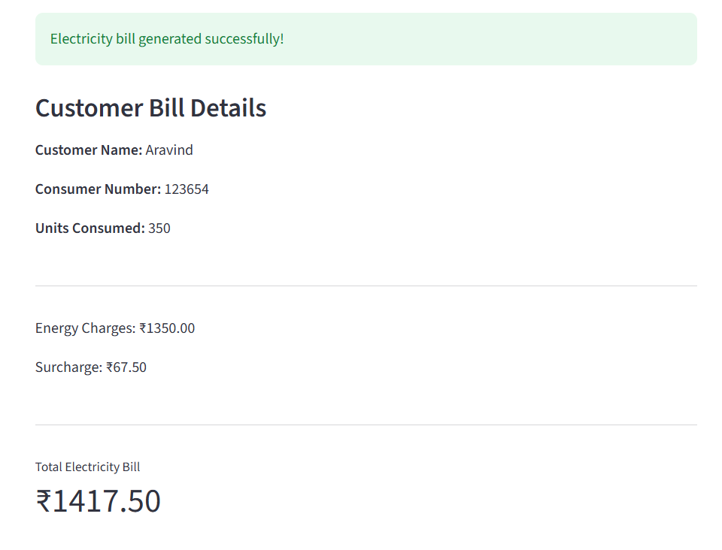
Electricity Bill Generation – Successful Output and Bill Calculation
Insights
A success message confirms that the electricity bill has been generated successfully.

Slide 11
Conclusion
The Electricity Bill Generator project automates electricity bill calculations using Python and Streamlit. It calculates energy charges based on predefined tariff slabs and applies the applicable surcharge. The application reduces manual effort, minimizes errors, and provides a user-friendly interface. It demonstrates Python concepts such as classes, objects, functions, and conditional statements. Overall, the project makes electricity billing simple, accurate, and efficient.

Slide 12
Recommendations
⮞ Add a database to store customer details and electricity billing records.
⮞ Provide an option to download electricity bills in PDF format.
⮞ Implement monthly billing reports to track electricity consumption.
⮞ Add a search feature to retrieve customer details using the consumer number.
⮞ Update billing rules according to the applicable electricity board regulations.

Slide 13


Slide 14

THANK YOU

